Slide 1
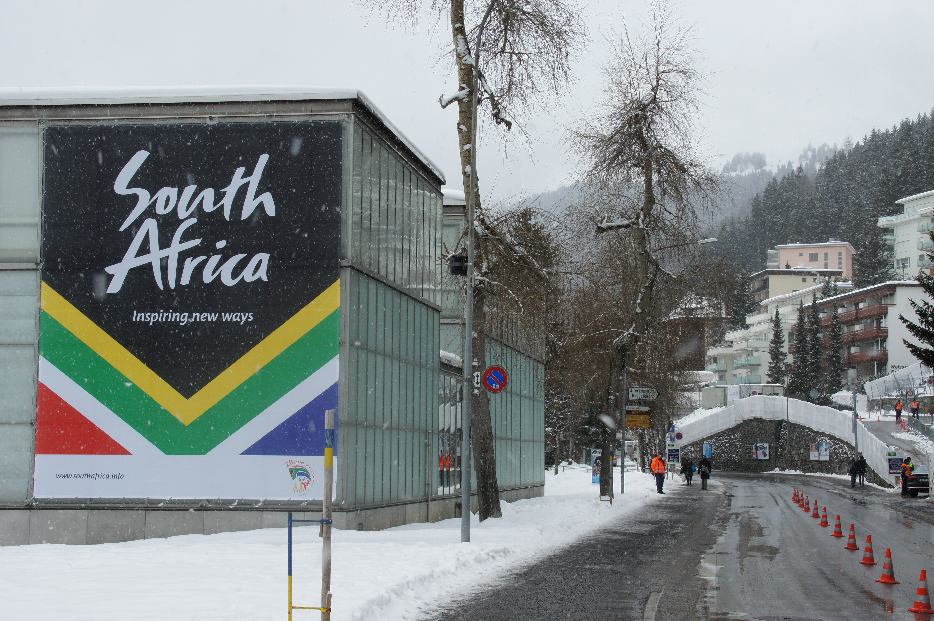
Brand
Local Government Tourism Conference Presentation
30 March 2015

Slide 2
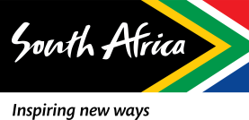
Brand South Africa - Mandate
National Priorities
GDP growth, job creation, poverty alleviation, social cohesion, National Vision for South Africa – Vision 2030
Desired impact
Increased international competitiveness
Improved international reputation
Increased
brand equity
Vision
South Africa acknowledged as a Top 20 Nation Brand and a Top 30 Nation
in the WEF Global Competitiveness Index by 2020
International mandate
To build South Africa’s Nation Brand reputation in order to improve South Africa’s global competitiveness
Domestic mandate
Build Pride & Patriotism amongst South Africans and contribute to social cohesion and nation brand ambassadorship
Strategic Objective – establish a compelling brand image for the country and position it favourably in order to attract, trade, tourism and investment

Slide 3
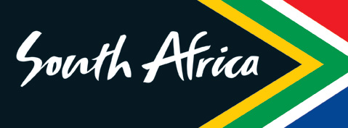










Benefits of nation branding…
Succeed in competition for share of voice & wallet in a crowded market place for:
  Inward investment
  Trade
  Exports
  Skills
  Tourism
  Donor Aid/Funding
Enhancing competitiveness and national prosperity
Enhancing social cohesion and unity

Slide 4
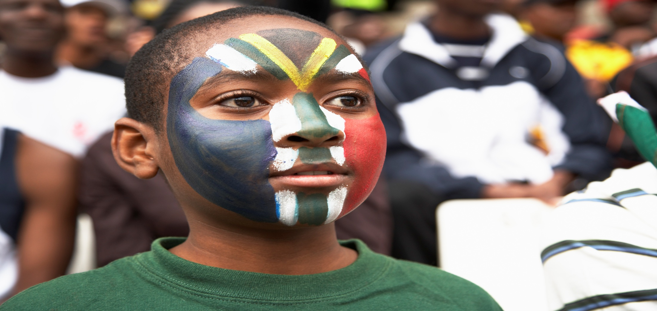
Nation Brands and Branding…
Nation Brand
Everything the Nation stands for; it is the creation of
the identity that will encompass what people know about
the Nation
Where do we come from? -Our heritage, culture etc.
What do we stand for? - Our promise, governance, foreign policy, our people etc.
Where are we going? - Vision 2030
Nation Branding Management
The practice of highlighting, encouraging, reinforcing, communicating and aligning a nation’s attributes in order to present the nation in a way that helps it reach defined strategic goals (Vision 2030)

Slide 5
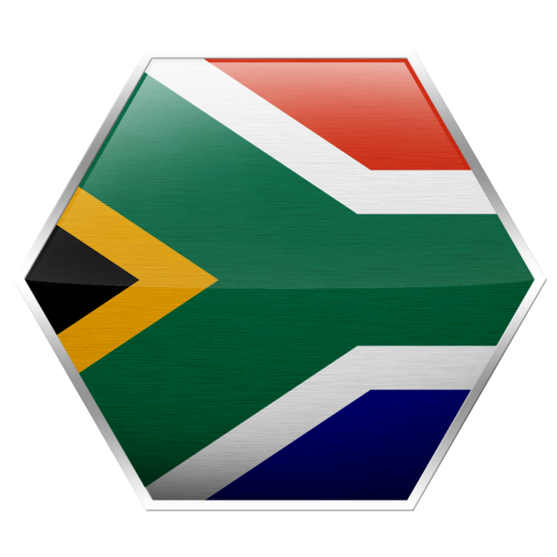
A nation brand is the sum of people’s perceptions of a country across
six core areas…
Investment Potential and attractiveness to outsiders
Investment & immigration
38
Potential attractiveness and economical contribution
Level of satisfaction with country’s products and services
Tourism
34
Exports
37
Competency fair governance, human rights, international contribution
Governance
40
People
34
Skills and openness
Culture & Heritage
27
Commercial and cultural products and sporting prowess

Slide 6
South Africa’s has adopted an umbrella brand approach to nation branding…
Brand South Africa Inc.
Investment
Tourism
Provinces, Cities
Exports
Heritage
Umbrella brand
Sub-brands
Notes:
6
1

Slide 7
Despite challenges SA’s reputation has remained relatively stable…
Reputation globally remains stable in years of global financial turmoil that impacted negatively on developed markets
Culture remains is its strongest asset and ranks highly for sporting excellence (16th)
With a strong People profile (34th globally), South Africans are admired across most panel countries.
Continues to rank 34th globally on Tourism, with strong perceptions as being naturally beautiful (15th).
Commonwealth nations and Western European countries continue to be South Africa’s greatest admirers.
Welcoming people and enjoyable country
Making a significant contribution to global culture
Potential for Higher Education opportunities
Perceived very positively in India, followed by China
Seen as a growing economy with potential for development
Infrastructure is a key attractiveness feature for international business
Transition to democracy and diversity seen as important reputation enhancers
(Sources: Nation Brand Index, City Brands Index, Investor Perceptions Survey)

Slide 8
SA performance in the City Brand Index
Background to the City Brand Index
The City Brand Index research report released every two years;
Research on perceptions of 50 cities is conducted in 10 core panel countries:
Western Europe: Amsterdam, Barcelona, Basel, Berlin, Brussels, Copenhagen, Dublin, Edinburgh, Geneva, London, Madrid, Milan, Paris, Rome, Stockholm
Central/Eastern Europe: Istanbul, Moscow, Prague, Vienna, Warsaw
Asia Pacific: Auckland, Bangkok, Beijing, Hong Kong, Melbourne, Mumbai, Seoul, Shanghai, Singapore, Sydney, Tokyo
North America: Boston, Chicago, Denver, Los Angeles, Montreal, New York, Philadelphia, Seattle, Toronto, Washington D.C.
Latin America: Buenos Aires, Mexico City, Rio de Janeiro
Middle East/Africa: Cairo, Cape Town, Doha, Dubai, Durban, Johannesburg

Slide 9
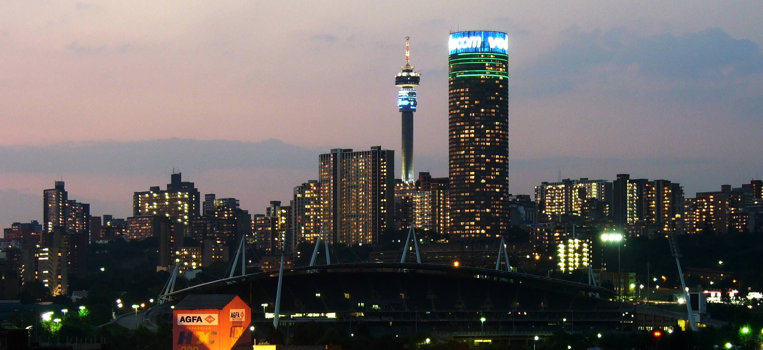
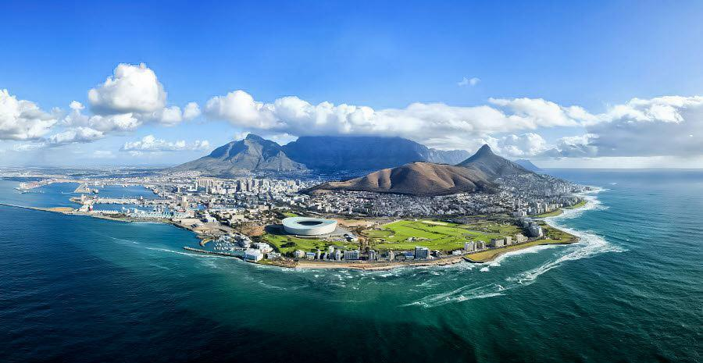
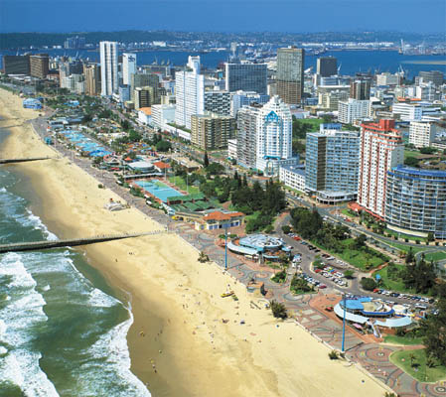
Although the South African cities face clear reputation challenges, they are becoming increasingly competitive…
City Brand Index – South African City Rankings
City | 2013 | 2011
Johannesburg | 44 | 45
Cape Town | 42 | 43
Durban | 47 | 47
Johannesburg saw the second largest CBISM score increase across all 50 measured cities in 2013, passing Mexico City for 44th place

Slide 10
High level findings on SA cities global reputation
Overall, global citizens are warmer towards Johannesburg than Durban (47th)
Picturesque Cape Town (42nd) outranks Johannesburg (44th).
Ranking in the bottom-tier on five of the six dimensions, Johannesburg is still facing the challenge of growing its reputation.
However, each of the six dimensions shows signs of growth.
The city’s physical attributes continue to be Johannesburg’s strength
Breaking out of the bottom-tier, Johannesburg passed Durban and Warsaw for its 39th position on the Place Index.
Relative strengths - accommodations and amenities (Pre-requisite Index) and its business and educational opportunities (Potential)
Shown notable improvements since CBISM 2011.
Johannesburg strengths: Accommodation & Amenities; Business & Education opportunities.
Of SA cities Durban ranks the highest ito Potential
Cape Town ranks highest ito Pulse
Durban ranks highest ito People
Durban ranks highest ito Pre-requisites
Cape Town ranks highest ito Place
Cape Town ranks highest ito Presence

Slide 11
And so place branding is more than just destination marketing…
“Nation Brand Management should be treated as a component of national policy and never as a “campaign” that is separate from planning, governance or economic development…”
Because
nation branding is about more than just logos and advertising…

Slide 12
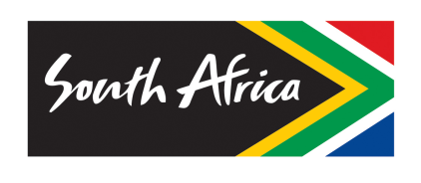
The Brand Positioning and Representation Journey So Far…
Beyond look and feel - towards vision and action alignment
Inspiring new ways
Alive with possibility
2004
2010
2012

Slide 13
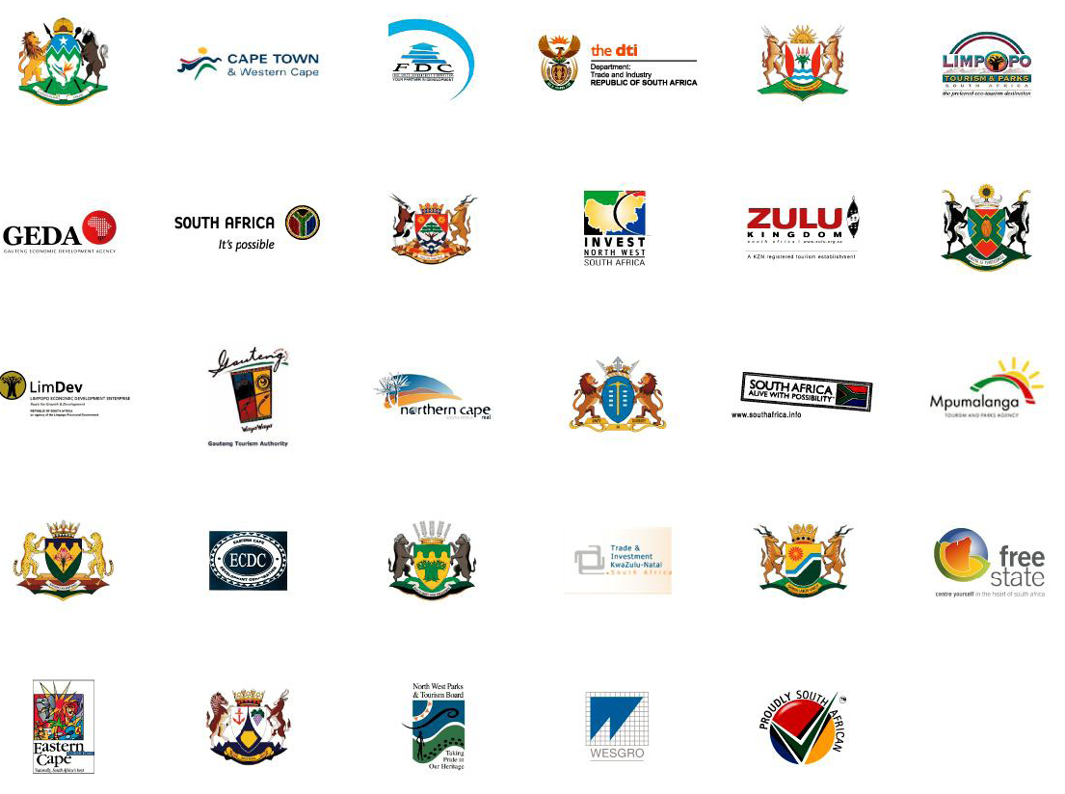
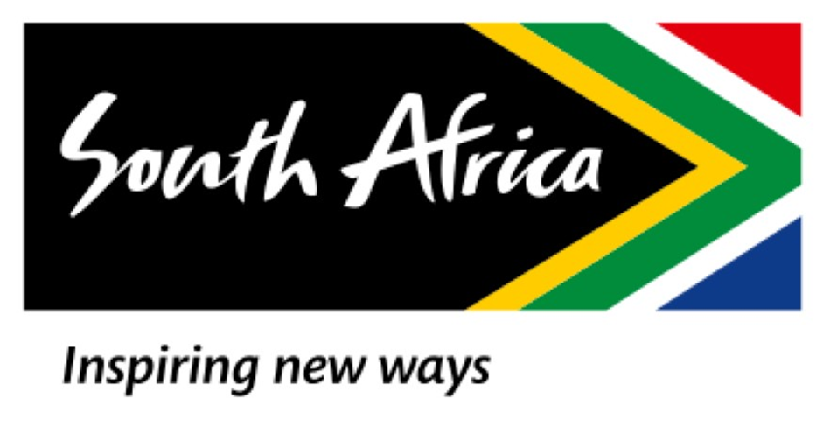
For Purposes of International Marketing We Moved…
From …
To …
Under the flag: country slogan ONLY
To encourage brand unity.
Drive awareness of South Africa’s proposition

Slide 14
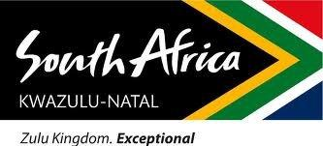
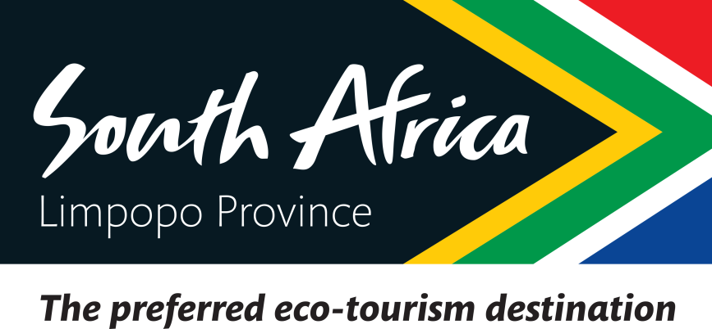
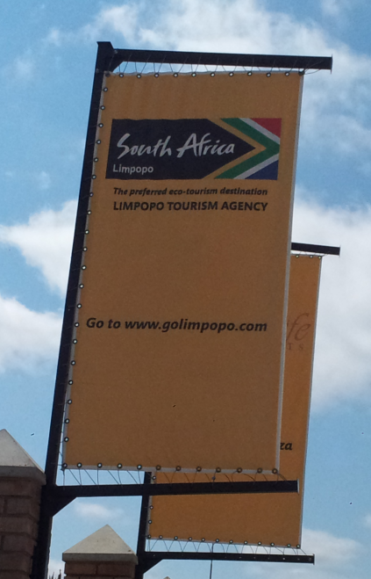
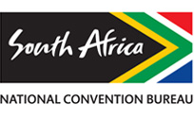
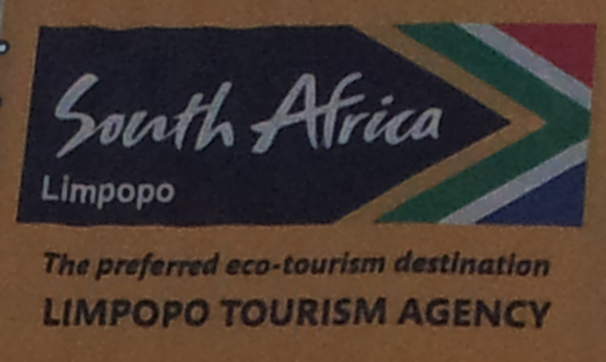
While deviations still exist, there is generally more alignment…

Slide 15
“Nation [place] brand-building has a lot more to do with the political-economy of competitiveness than simple marketing and communications”
Notes:
15
1

Slide 16
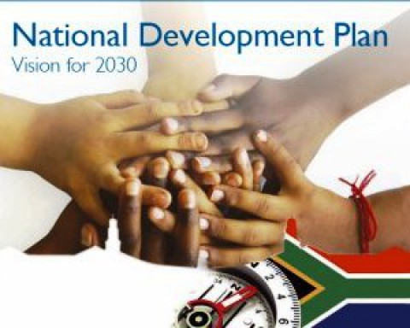
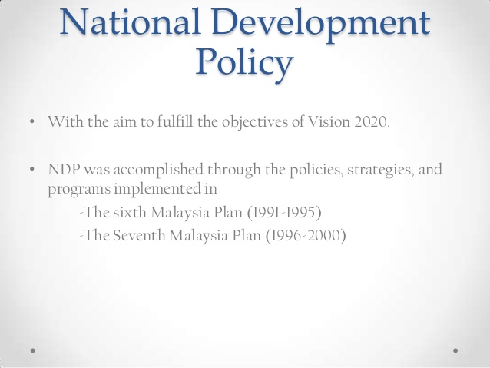

Best practice in effective place branding requires more than just look and feel alignment and compliance…
Long term vision - Vision 2030
Strategy/policy
Substance - Good leadership and governance
        - Economic and social reforms
        - Imaginative and effective cultural and political relations
        - Transparency and integrity
        - Infrastructure
        - Education, Innovation
Action - Actions that bring the substance
to the world’s attention/awareness
- Buy in and action by citizens

Slide 17
What is required to earn a strong brand reputation?
“Reputation is not about what you say but what you do”:
Vision &
Policies
FDI, Exports
Tourism
International Development
Cultural
Relations
International
Events
Public & Pvt Diplomacy
Multilateral
Engagements
Coordination
Govt/Bus/Civ
Innovation
Investment
Education

Slide 18

We need to build the brand from the inside out…
Competitiveness
Reputation/Image
Civic Pride
Active Citizenship

Slide 19
The Bigger Picture
Goal:
Vision 2030
How: Play Your Part
Who: South African Citizen? (incl GSA)
Focus: Government
Business
Civil Society
Media
Youth

Slide 20
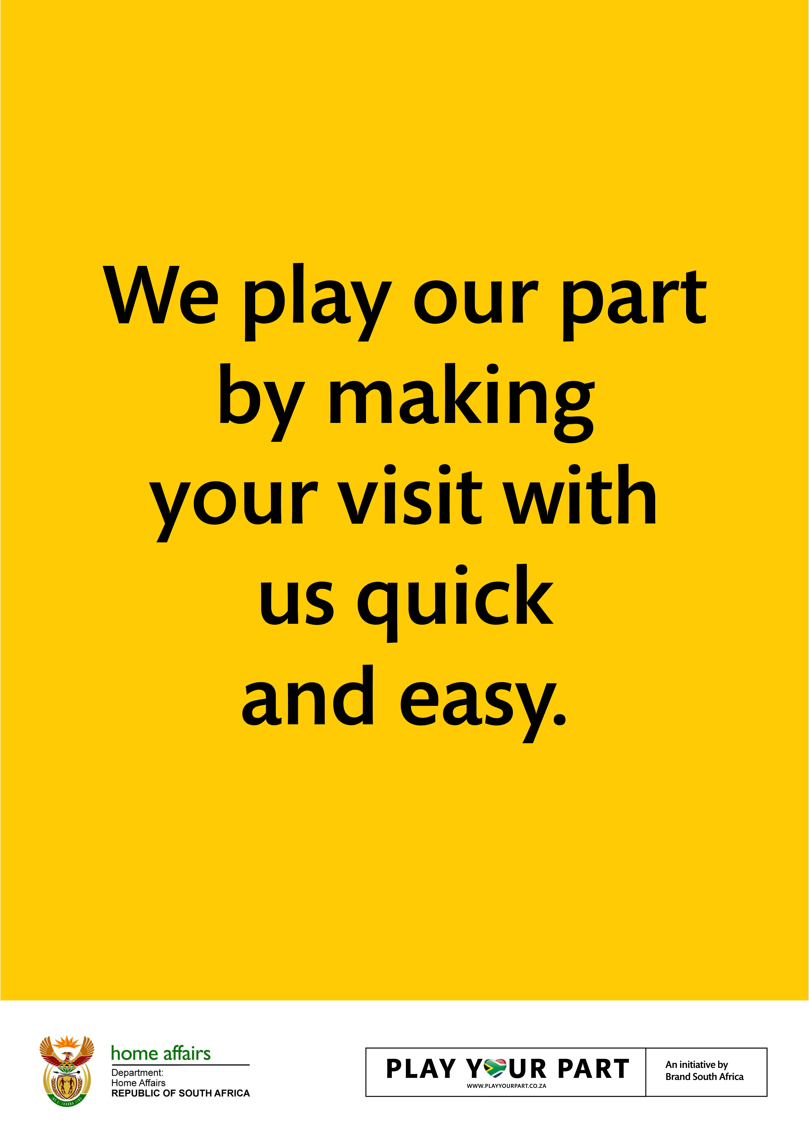
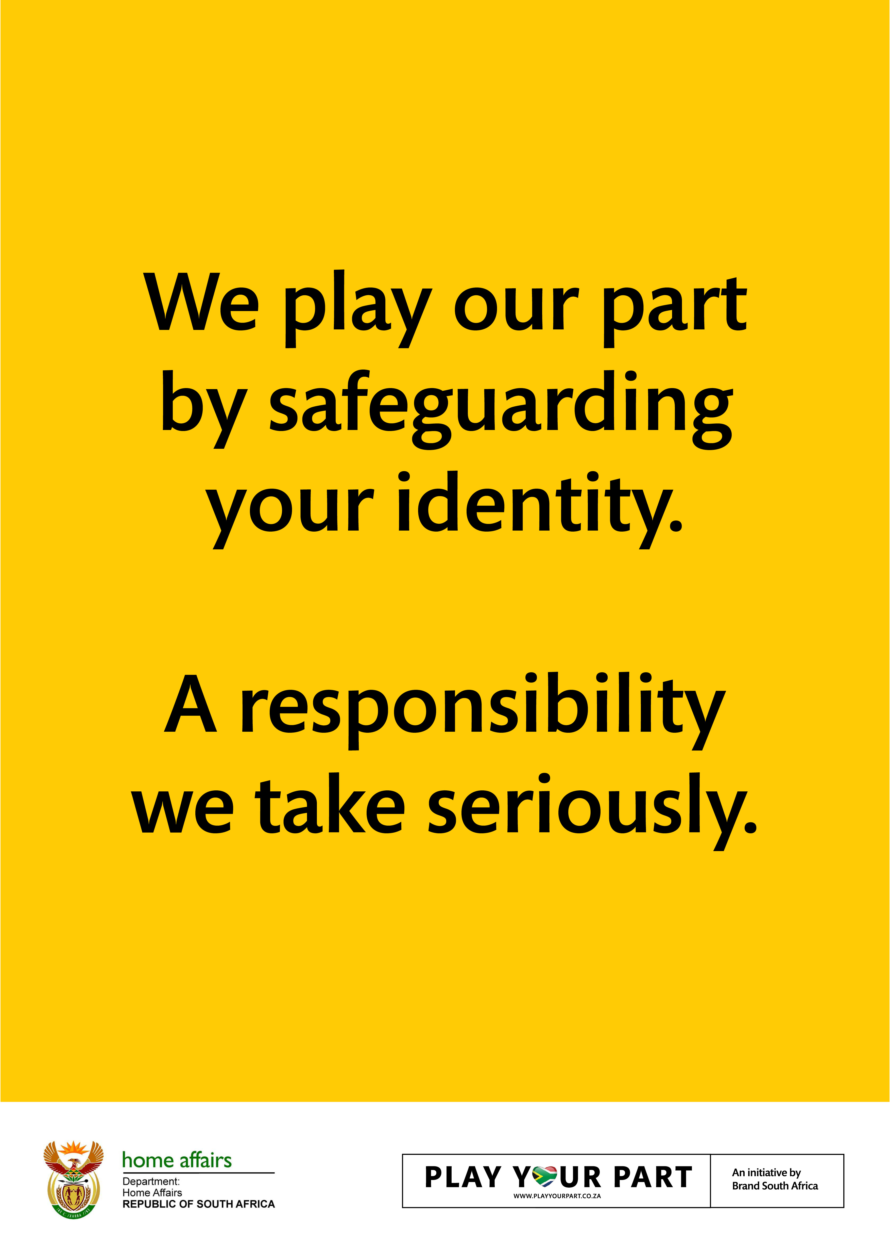
Example - Home Affairs………

Slide 21
“The ability to affect a nation’s image lies firmly in the hands of its policy makers”
Notes:
21
1

Slide 22
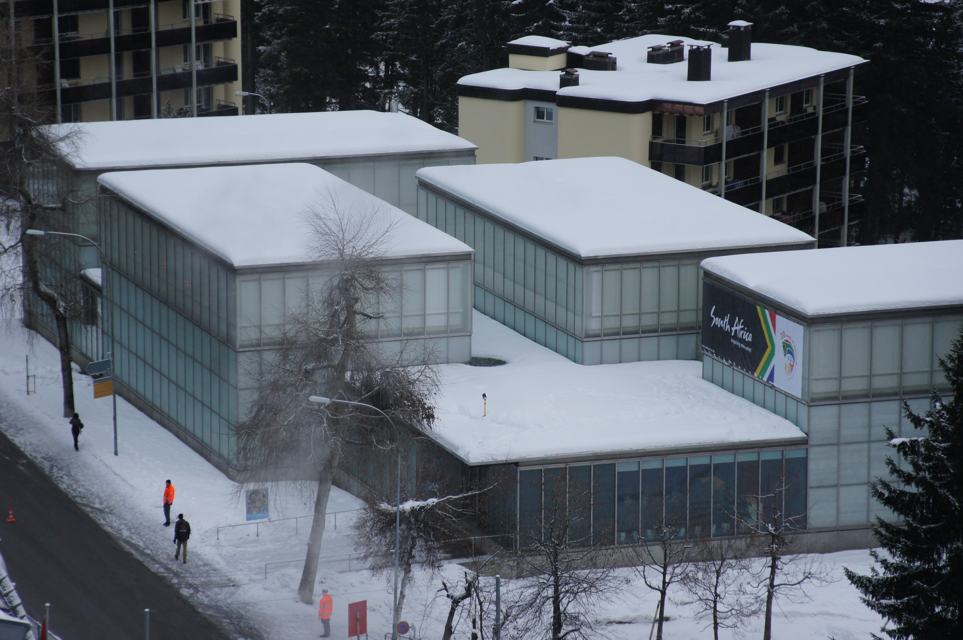
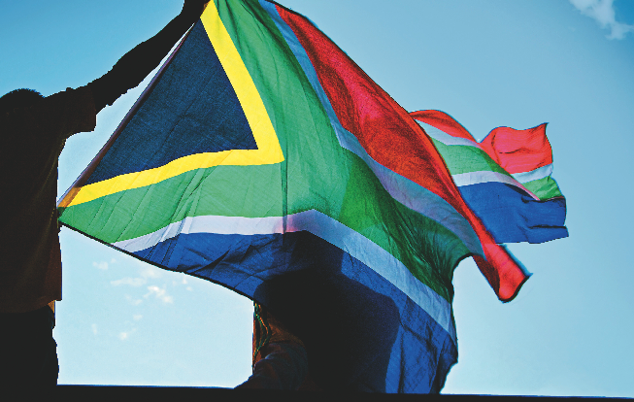
Thank You

